Slide 1
Buffer Overflow Attacks

Slide 2
Buffer Overflow These Days
Most common cause of Internet attacks
  Over 50% of advisories published by CERT (computer security incident report team) are caused by various buffer overflows
Morris worm (1988): overflow in fingerd
  6,000 machines infected
CodeRed (2001): overflow in MS-IIS server
  300,000 machines infected in 14 hours
SQL Slammer (2003): overflow in MS-SQL server
  75,000 machines infected in 10 minutes

Slide 3
Attacks on Memory Buffers
Buffer is a data storage area inside computer memory (stack or heap)
  Intended to hold pre-defined amount of data
    If more data is stuffed into it, it spills into adjacent memory
  If executable code is supplied as data, victim’s machine may be fooled into executing it
    Code will self-propagate or give attacker control over machine
First generation exploits: stack smashing
Second gen: heaps, function pointers
Third generation: format strings and heap management structures

Slide 4
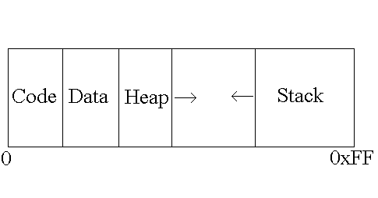
Process Memory Organization
Code region includes the instructions.
Data region includes data such as static variables.
Heap region used for dynamic allocation.
Stack used for function calls.

Slide 5
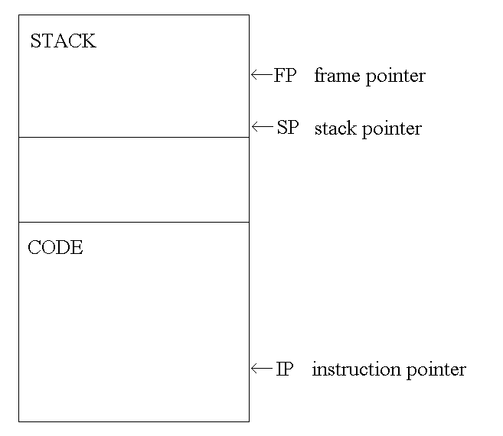
Process Memory Organization
Stack pointer (SP) points to last address on the stack.
Frame pointer (FP) points to a fixed location on stack.
  Used for accessing local variables and parameters.
Instruction Pointer (IP) points to current position in code

Slide 6
Process Memory Organization
Suppose a program contains this function
void func(char *str) {
char buf[126];
strcpy(buf,str);
}
When this function is invoked, a new frame with local variables is pushed onto the stack
Allocate local buffer
(126 bytes reserved on stack)
Copy argument into local buffer
Stack grows this way
buf
sfp
ret
addr
str
Frame of the
calling function
Top of
stack
Local variables
Pointer to
previous
frame
Execute
code at
this address
after func()
finishes
Arguments

Slide 7
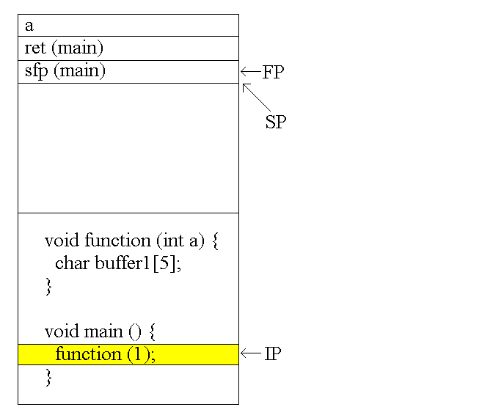
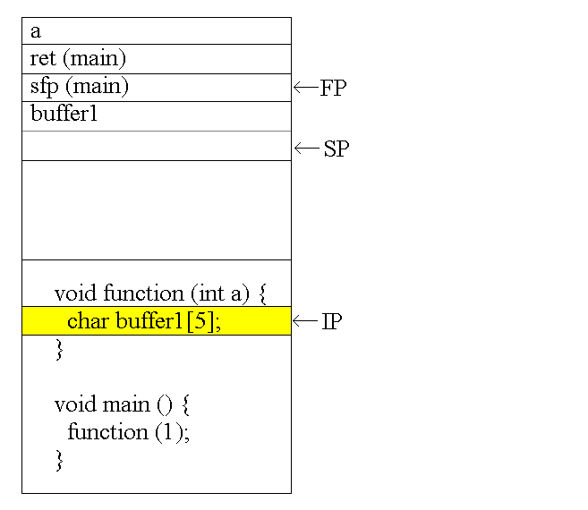
Process Memory Organization

Slide 8
Buffer Overflow
Memory pointed to by str is copied onto stack…
void func(char *str) {
char buf[126];
strcpy(buf,str);
}
If a string longer than 126 bytes is copied into buffer, it will overwrite adjacent stack locations
strcpy does NOT check whether the string
at *str contains fewer than 126 characters
buf
overflow
str
Frame of the
calling function
Top of
stack
This will be
interpreted
as return address!

Slide 9
Buffer Overflow
void function(char *str)
{
char buffer[8];
strcpy(buffer,str);
}
void main()
{
char large_string[256];
int i;
for( i = 0; i < 255; i++)
large_string[i] = 'A';
function(large_string);
}

Slide 10
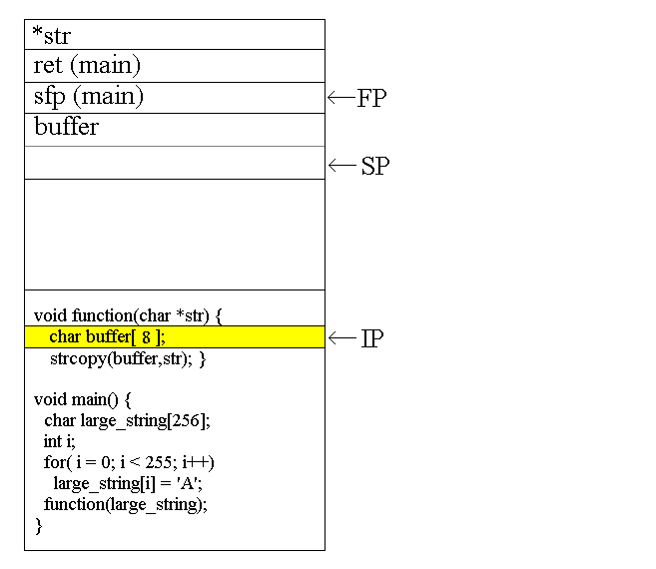
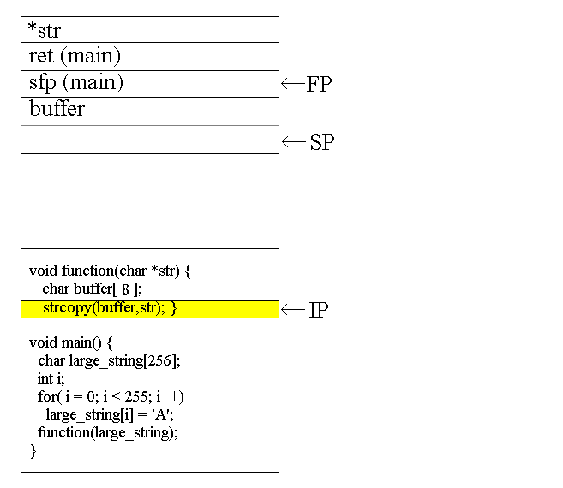
Buffer Overflow

Slide 11
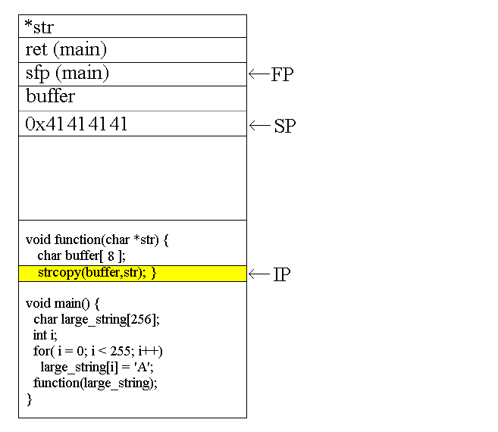
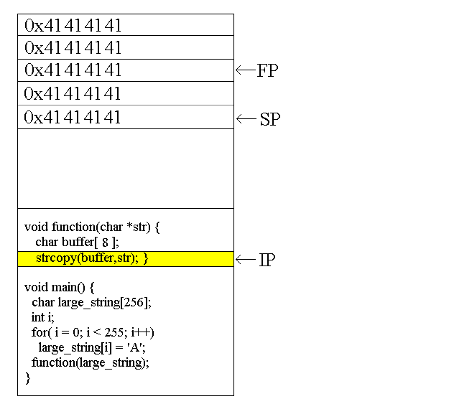
Buffer Overflow

Slide 12
Executing Attack Code
Suppose buffer contains attacker-created string
  For example, *str contains a string received from the network as input to some network service daemon
When function exits, code in the buffer will be
executed, giving attacker a shell
  Root shell if the victim program is setuid root
code
ret
str
Top of
stack
Frame of the
calling function
Attacker puts actual assembly
instructions into his input string, e.g.,
binary code of execve(“/bin/sh”)
In the overflow, a pointer back
into the buffer appears in
the location where the system
expects to find return address

Slide 13
Modifying Execution Flow
void function()
{
char buffer1[4];
int *ret;
ret = buffer1 + 8;
(*ret) += 8;
}
void main()
{
int x = 0;
function();
x = 1;
printf("%d\n",x);
}

Slide 14
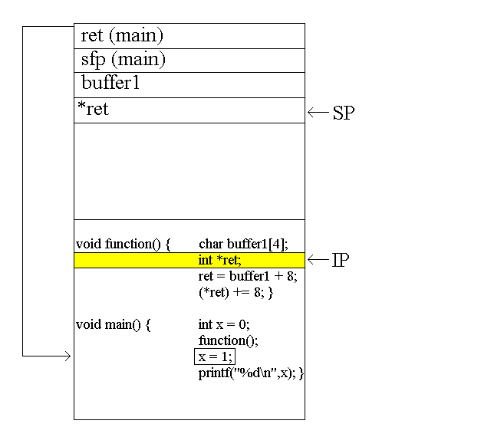
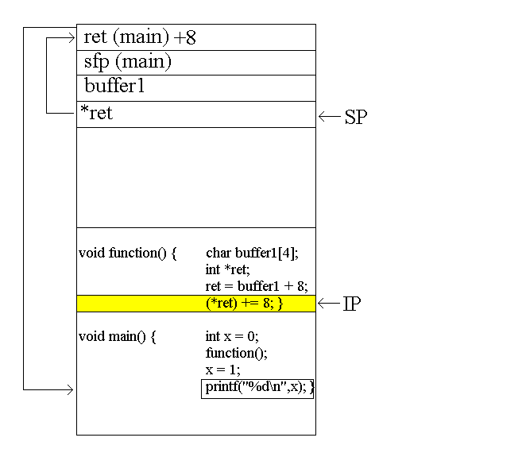
Modifying Execution Flow

Slide 15
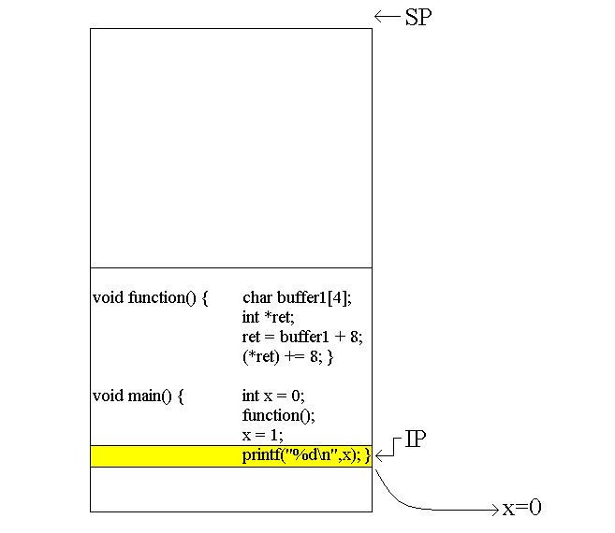
Modifying Execution Flow

Slide 16
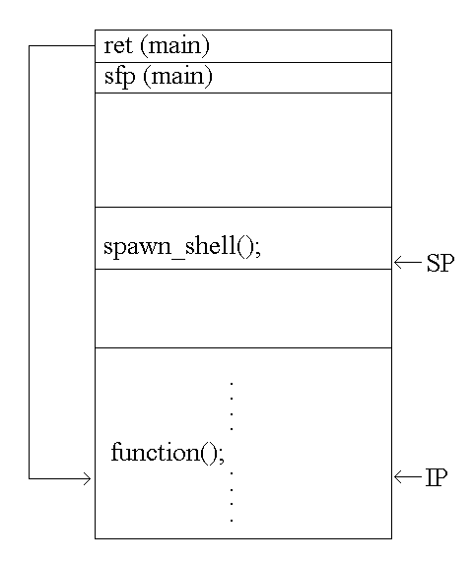
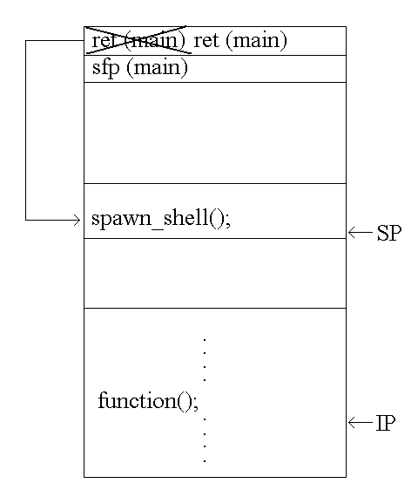
Executing Attack Code

Slide 17
Spawning a Shell
char shellcode[] = "\xeb\x2a\x5e\x89\x76\x08\xc6\x46\x07\x00\xc7\x46\x0c\x00\x00\x00" "\x00\xb8\x0b\x00\x00\x00\x89\xf3\x8d\x4e\x08\x8d\x56\x0c\xcd\x80" "\xb8\x01\x00\x00\x00\xbb\x00\x00\x00\x00\xcd\x80\xe8\xd1\xff\xff" "\xff\x2f\x62\x69\x6e\x2f\x73\x68\x00\x89\xec\x5d\xc3";

Slide 18
Problem: No Range Checking
strcpy does not check input size
  strcpy(buf, str) simply copies memory contents into buf starting from *str until “\0” is encountered, ignoring the size of area allocated to buf
Many C library functions are unsafe
  strcpy(char *dest, const char *src)
  strcat(char *dest, const char *src)
  gets(char *s)
  scanf(const char *format, …)
  printf(const char *format, …)

Slide 19
More Buffer Overflow Targets
Heap management structures used by malloc()
URL validation and canonicalization
  If Web server stores URL in a buffer with overflow, then attacker can gain control by supplying malformed URL
    Nimda worm propagated itself by utilizing buffer overflow in Microsoft’s Internet Information Server
Some attacks don’t even need overflow
  Naive security checks may miss URLs that give attacker access to forbidden files
    For example, http://victim.com/user/../../autoexec.bat may pass naïve check, but give access to system file.

Slide 20
Heap Overflow
Overflowing buffers on heap can change pointers that point to important data
  Sometimes can also transfer execution to attack code
  Can cause program to crash by forcing it to read from an invalid address (segmentation violation)
Illegitimate privilege elevation: if program with overflow has sysadm/root rights, attacker can use it to write into a normally inaccessible file
  For example, replace a filename pointer with a pointer into buffer location containing name of a system file
    Instead of temporary file, write into AUTOEXEC.BAT

Slide 21
Function Pointer Overflow
C uses function pointers for callbacks: if pointer to F is stored in memory location P, then another function G can call F as (*P)(…)
Buffer with attacker-supplied
input string
Callback
pointer
Heap
attack code
overflow
Legitimate function F
(elsewhere in memory)

Slide 22
Preventing Buffer Overflow
Use safe programming languages, e.g., Java
  What about legacy C code?
Mark stack as non-executable
Randomize stack location or encrypt return address on stack by XORing with random string
  Attacker won’t know what address to use in his string
Static analysis of source code to find overflows
Run-time checking of array and buffer bounds
  StackGuard, libsafe, many other tools
Black-box testing with long strings

Slide 23
Non-Executable Stack
NX bit on every Page Table Entry
  AMD Athlon 64, Intel P4 “Prescott”, but not 32-bit x86
  Code patches marking stack segment as non-executable exist for Linux, Solaris, OpenBSD
Some applications need executable stack
  For example, LISP interpreters
Does not defend against return-to-libc exploits
  Overwrite return address with the address of an existing library function (can still be harmful)
…nor against heap and function pointer overflows

Slide 24
Randomized Stack Location
Stack grows this way
buf
sfp
ret
addr
str
Frame of the
calling function
Top of
stack
Have a random string RNDSTR
XOR return address with RNDSTR
Store in ret addr field
Stack grows this way
buf
sfp
Ret Addr
XOR
RNDSTR
str
Frame of the
calling function
Top of
stack
XOR the entry with RNDSTR again to get the ret addr
(A XOR B) XOR B = A
Attacker can not make return address point to buffer

Slide 25
Networking Background
ARP and DHCP

Slide 26
MAC Addresses and ARP
32-bit IP address:
  network-layer address
  used to get datagram to destination IP subnet
MAC (or LAN or physical or Ethernet) address:
  used to get datagram from one interface to another physically-connected interface (same network)
  48 bit MAC address (for most LANs)
  burned in the adapter ROM

Slide 27

LAN Addresses and ARP
Each adapter on LAN has unique LAN address
1A-2F-BB-76-09-AD
Broadcast address =
FF-FF-FF-FF-FF-FF
LAN
(wired or
wireless)
71-65-F7-2B-08-53
= adapter
58-23-D7-FA-20-B0
0C-C4-11-6F-E3-98

Slide 28
LAN Address (more)
MAC address allocation administered by IEEE
manufacturer buys portion of MAC address space (to assure uniqueness)
Analogy:
(a) MAC address: like Social Security Number
(b) IP address: like postal address
MAC flat address ➜ portability
  can move LAN card from one LAN to another
IP hierarchical address NOT portable
  depends on IP subnet to which node is attached

Slide 29
ARP: Address Resolution Protocol
Each IP node (Host, Router) on LAN has ARP table
ARP Table: IP/MAC address mappings for some LAN nodes
< IP address; MAC address; TTL>
  TTL (Time To Live): time after which address mapping will be forgotten (typically 20 min)
Question: how to determine MAC
address of B knowing B’s IP address?
237.196.7.78
1A-2F-BB-76-09-AD
237.196.7.23
237.196.7.14
LAN
71-65-F7-2B-08-53
58-23-D7-FA-20-B0
0C-C4-11-6F-E3-98
237.196.7.88

Slide 30
ARP protocol: Same LAN (network)
A wants to send datagram to B, and B’s MAC address not in A’s ARP table.
A broadcasts ARP query packet, containing B's IP address
  Dest MAC address = FF-FF-FF-FF-FF-FF
  all machines on LAN receive ARP query
B receives ARP packet, replies to A with its (B's) MAC address
  frame sent to A’s MAC address (unicast)
A caches (saves) IP-to-MAC address pair in its ARP table until information becomes old (times out)
  soft state: information that times out (goes away) unless refreshed
ARP is “plug-and-play”:
  nodes create their ARP tables without intervention from net administrator

Slide 31
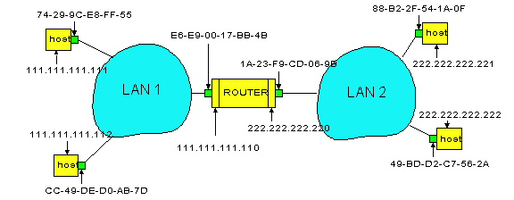
Routing to another LAN
send datagram from A to B via R assume A know’s B IP address
Two ARP tables in router R, one for each IP network (LAN)
In routing table at source Host, find router 111.111.111.110
In ARP table at source, find MAC address E6-E9-00-17-BB-4B, etc
A
R
B

Slide 32
A
R
B
A creates datagram with source A, destination B
A uses ARP to get R’s MAC address for 111.111.111.110
A creates link-layer frame with R's MAC address as dest, frame contains A-to-B IP datagram
A’s adapter sends frame
R’s adapter receives frame
R removes IP datagram from Ethernet frame, sees its destined to B
R uses ARP to get B’s MAC address
R creates frame containing A-to-B IP datagram sends to B

Slide 33
DHCP: Dynamic Host Configuration Protocol
Consider connecting a laptop to a network, you need an IP address that belongs to that network for routing to work.
Dynamically assigns IP addresses to hosts.
DHCP is a client-server protocol.
Typically each subnet has a DHCP server
If no DHCP server is present on the subnet, a DHCP relay agent that knows the address of a DHCP server is necessary.

Slide 34
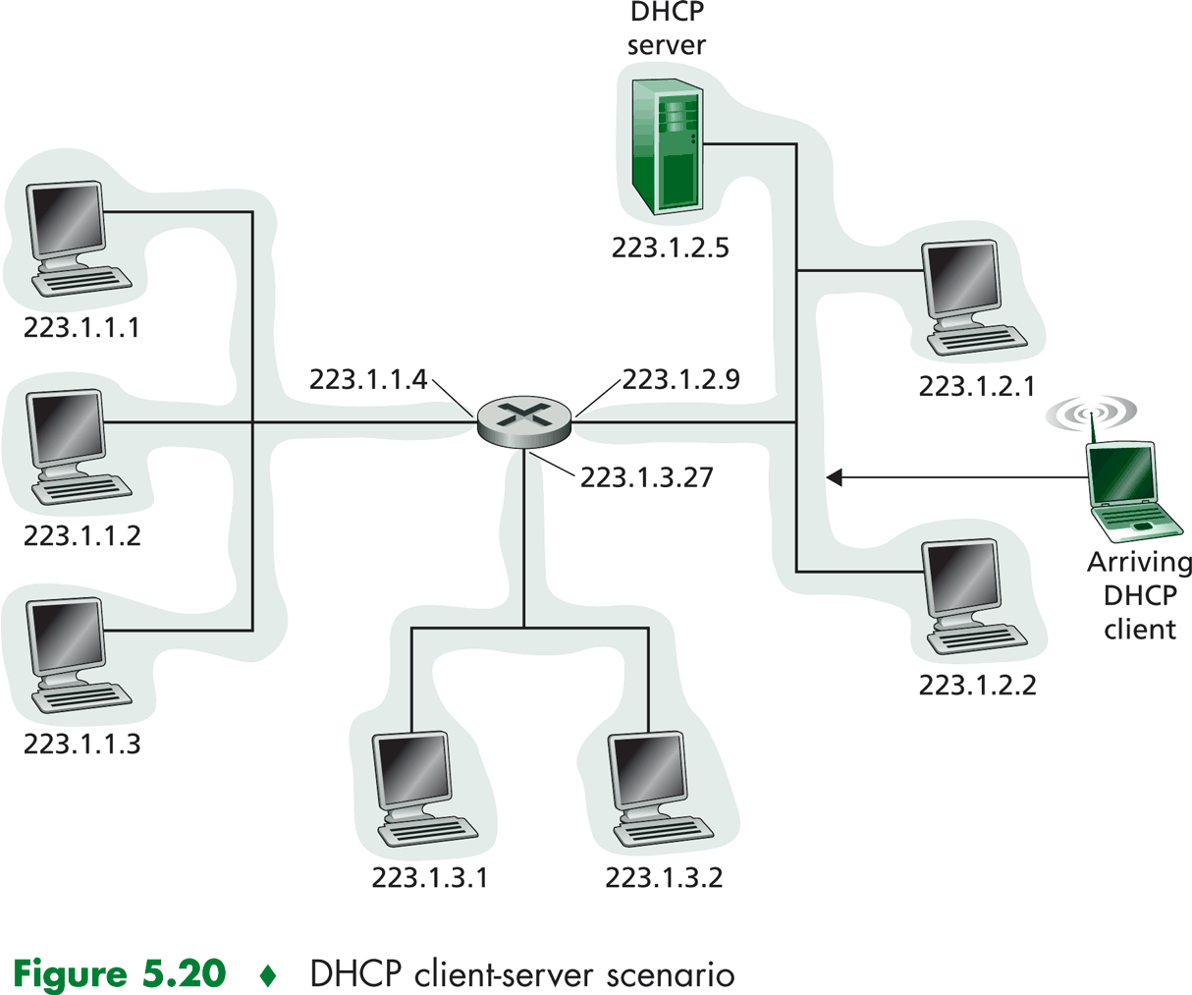
DHCP: Dynamic Host Configuration Protocol

Slide 35
DHCP: Dynamic Host Configuration Protocol
DHCP Server Discovery
  Find a DHCP Server with which to interact
DHCP Server Offers
  DHCP server responds with DHCP offer message
  Multiple offers possible if multiple DHCP servers
DHCP Request
  Select one offer and respond to it
DHCP ACK
  Server confirms requested parameters

Slide 36
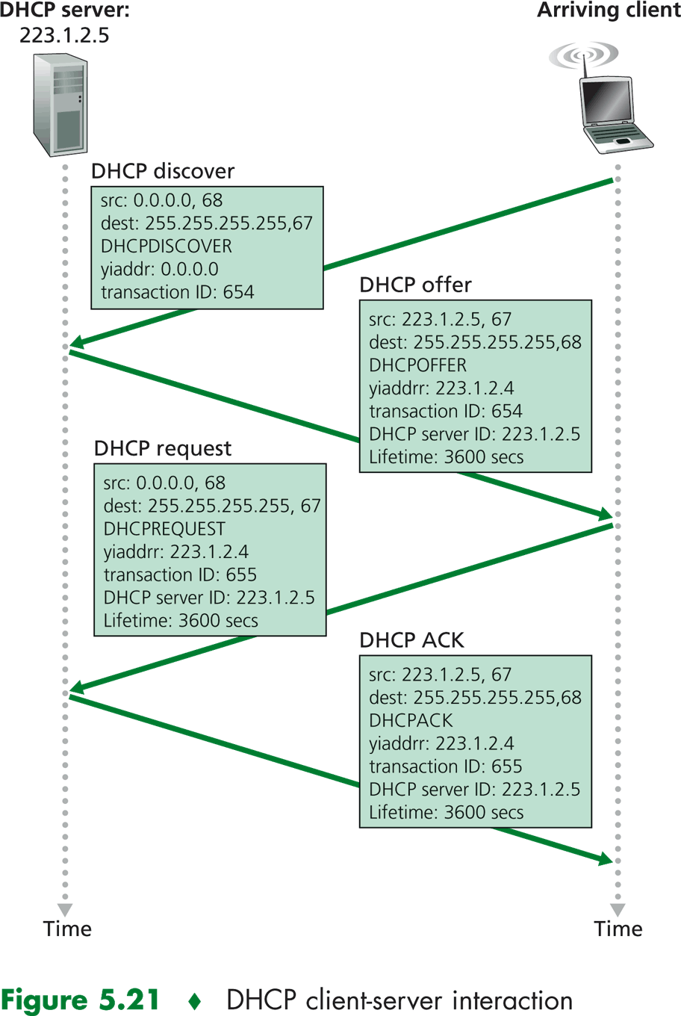
DHCP: Dynamic Host Configuration Protocol

